Slide 1
Final Project Predicting Energy Consumption based on Weather Forecasts Presentation
Chris Kellam, Eric Lidiak, Matthew Smith, Molly Fox, Jason Britton

Slide 2
Project Summary
TOPIC: Predicting Energy Consumption based on Weather Forecasts
DESCRIPTION
Create a predictive model based on historical weather and energy consumption data to forecast energy consumption based on weather variables such as minimum, maximum and average temperature, state, and month of year.
RESEARCH QUESTIONS
What types of historical data are available for weather and energy consumption?
Is weather data a good predictor of energy consumption?
How do different models’ compare to one another for time-series prediction?

Slide 3
Data and Delivery
Datasets
Energy Data: U.S. Energy Information Administration https://www.eia.gov
Weather Data: https://asmith.ucdavis.edu/data/prism-weather
Each team member took a potential model library (ARIMA, Prophet, Random Forest, LSTM, XGBoost) to compare and contrast the libraries predictive power using the two data sets.
The weather data began in January 1981 and continued through December 2023. The energy data began in January 2001 and continued through September 2024. We narrowed the scope of the combined data from January 2001 to December 2023.
Preprocessing was conducted jointly and individually based on the needs of the various models.

Slide 4
Feature Engineering
The team used the same features and target to test predictions:
Features: tmin, tmax, tavg, year, month, state_Texas
Target: coal
Initial attempts to model with one-hot encoded states resulted in excessive dimensionality.
Considered adding numeric values for states and regions, but this could cause models to treat categorical variables as continuous.
Some models calculated sine and cosine to capture cyclical patterns.

Slide 5
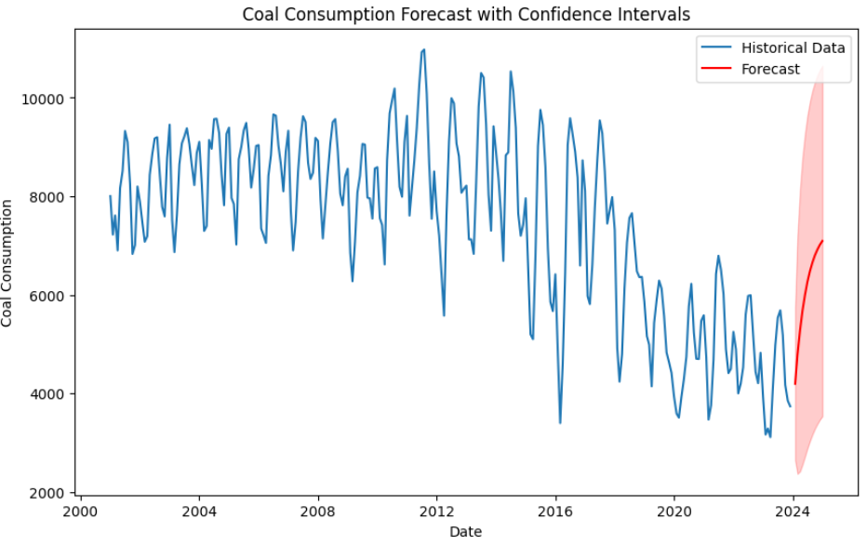
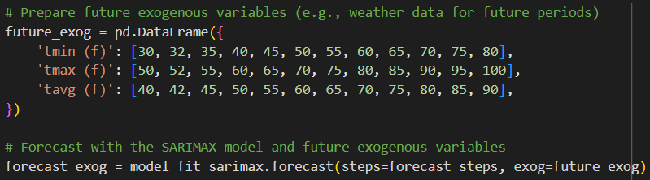
Model: ARIMA
The ARIMA model had an average RMSE value of 1771.17, Mean Absolute Error of 1494.48, and R-squared value of 0.06 (indicating the model explains only about 6.32% of the variability in coal consumption).
Auto-ARIMA was used to find the best parameters. “ARIMA(2,1,1)(0,0,0)[0]” was identified to be the best model.
The model was asked to predict coal consumption for January to May 2024 based off of data from January 2001 to December 2023:
Predicted coal consumption
January 2024 | 4193
February 2024 | 4789
March 2024 | 5276
April 2024 | 5673
May 2024 | 5998

Slide 6
Meta Prophet
Prophet is a model from Meta/ Facebook
The model only allows one input parameter
The model does allow for seasonality and holidays
Neural Prophet may have better results

Slide 7
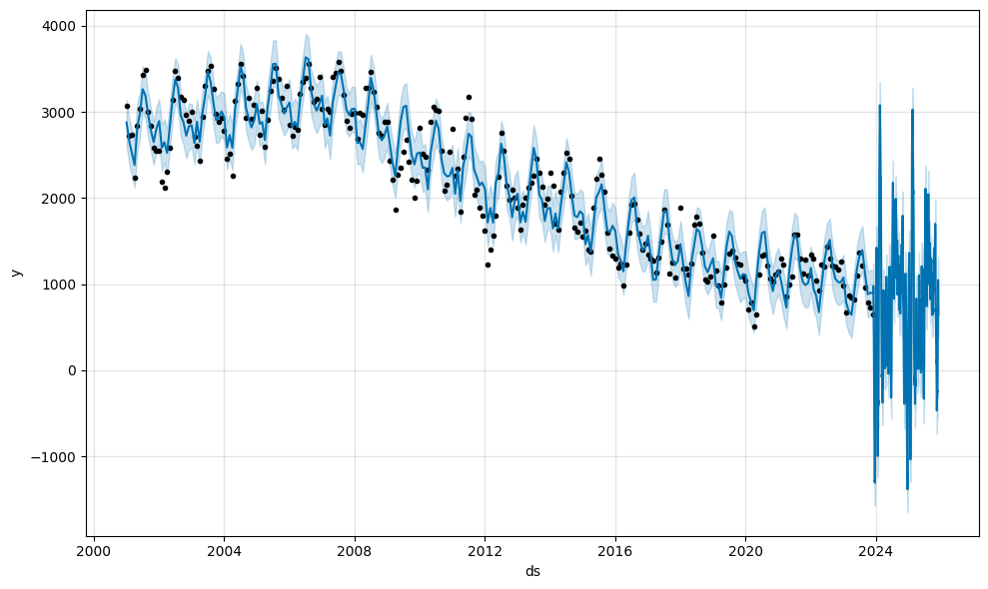
Meta Prophet

Slide 8
Meta Prophet
horizon mse rmse mae
0 37 days 1.093213e+06 1045.568034 827.816340
1 38 days 1.087036e+06 1042.610281 828.718786
2 40 days 1.065286e+06 1032.126874 814.787089
3 41 days 1.059688e+06 1029.411259 811.562895
4 42 days 1.091931e+06 1044.955242 842.449406

Slide 9
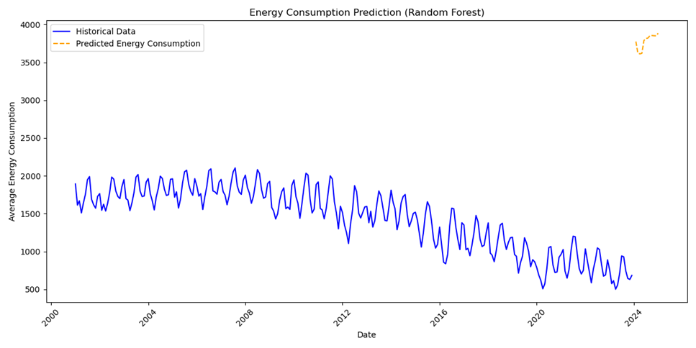
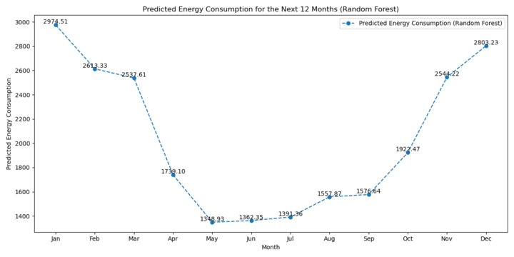
Model: Random Forest
Initial Model Performance - MSE: 3,045,606 and R²: 0.26.
After tuning with RandomizedSearchCV – MAE: 881 and R²: 0.47, indicating 47% of the variability in energy consumption is captured.
The model shows some predictive capability for time-series.

Slide 10
Model: Random Forest
Random Forest Time-Series Analysis Challenges:
The model assumes that observations are independent and non-sequential, which is not the case in time-series data.
It does not effectively utilize lagged values and seasonal indicators, which are crucial for capturing temporal patterns.
The decision trees used in the model split the data into homogeneous groups that fail to capture cyclical patterns or trends over time.
Random forest is prone to overfitting, which can lead to poor performance when applied to time-series data.

Slide 11
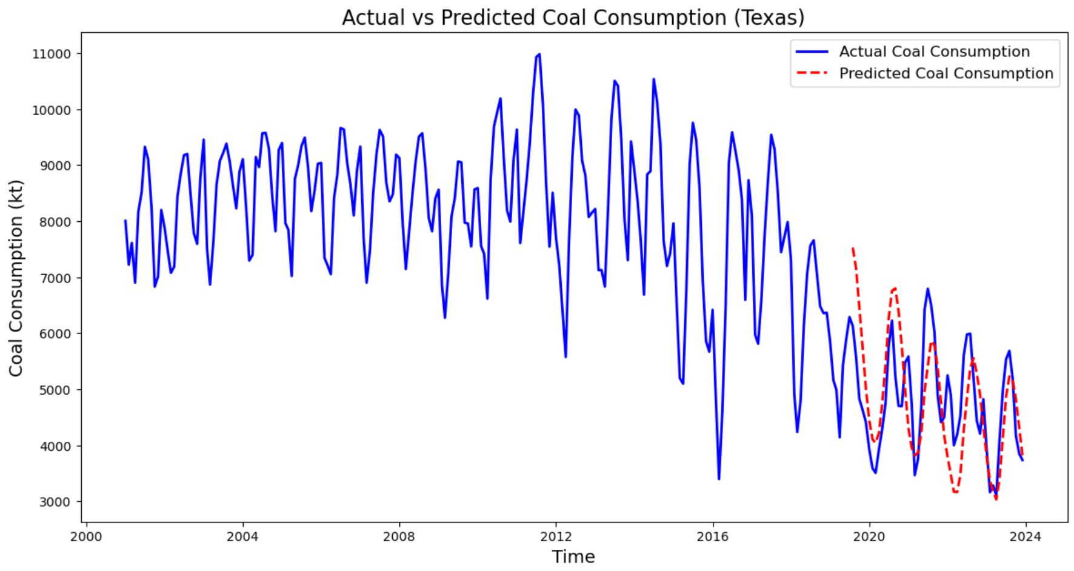
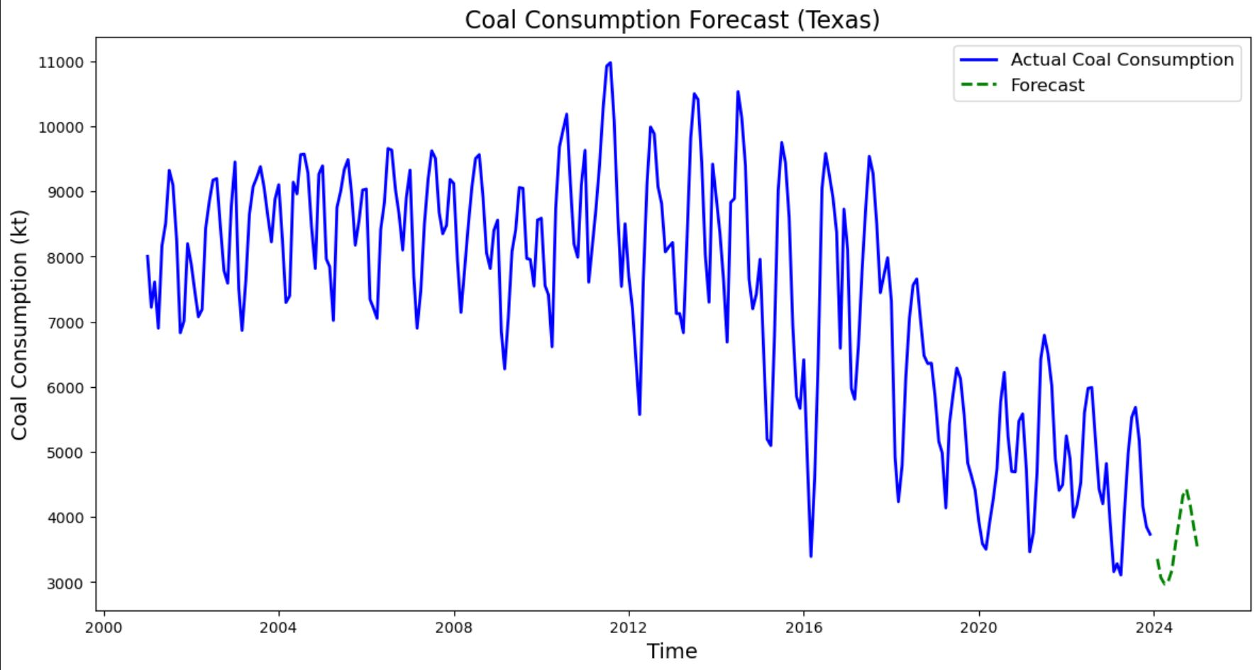
Model: LSTM
The best results were a MAE of 729.74, RMSE of 864.43, and R² score of 0.10%.
The parameters used for this model were: sequence length: 15, 1 hidden layer, 50 units/layer, 50 epochs.
I tried using an optimization function to find the best parameters for this model, but it was unable to find anything that performed better than what used for the above model.

Slide 12
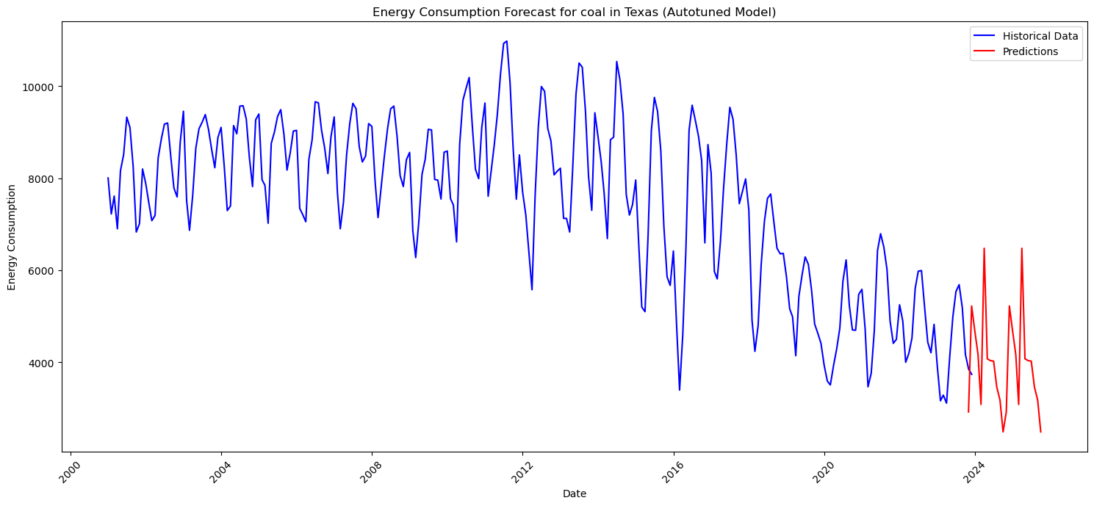
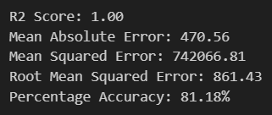
Model: XGBoost
The XGBoost model had a predictive accuracy of 81.18% with an average RMSE value of 861.43.
Autotuning was used for dialing the model in. The best parameters were: {'subsample': 1.0, 'n_estimators': 2000, 'min_child_weight': 5, 'max_depth': 5, 'learning_rate': 0.3, 'colsample_bytree': 1.0}
Given values for Texas in December 2023 for the various features:
'year': [2025], 'month_num': [12], 'tmin': [2.652], 'tmax': [15.471], 'tavg': [9.062], 'ppt': [94.212]
The model was asked to predict coal consumption for Texas in December 2025. The model predicted a value of 2871
thousand tons. The actual coal
consumption for Texas in December
2023 was 3736. A difference of 865
thousand tons.

Slide 13
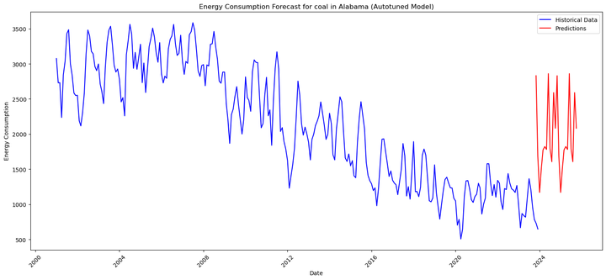
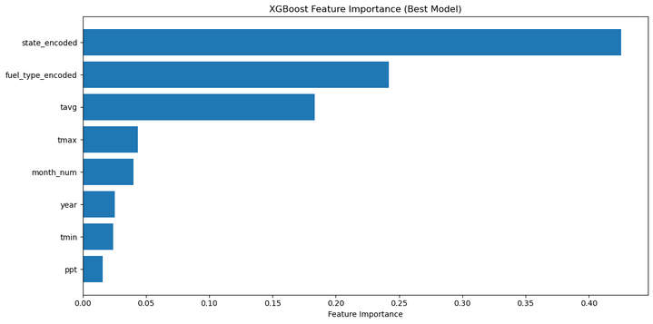
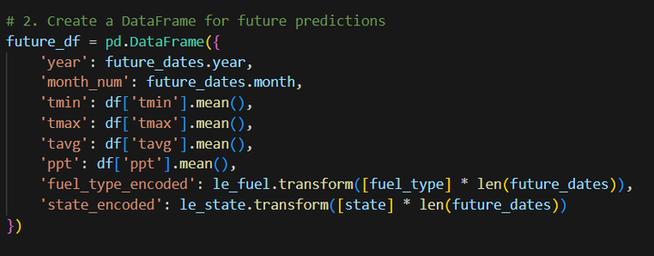
Model: XGBoost
Finding: State turned out to be the most important feature.
Test: Running Alabama for coal consumption in December with average temperature and precipitation values for all 50 states returned poorer results.
Conclusion: For accurate model prediction, parameters should correlate to those appropriate for the state during that time frame.

Slide 14
Key Observations
Weather data serves as a decent predictor of energy consumption, as indicated by the models' predictive capabilities.
Monthly weather trends reveal that average temperature patterns correlate with energy consumption, highlighting the influence of seasonal changes.
Weather temperatures—both hot and cold—are likely to impact on future energy consumption, necessitating further analysis to understand their effects.
The biggest factor in determining accuracy is what data you are using.

Slide 15
Model Accuracy
 | ARIMA | Prophet | Random | LSTM | XGBoost
Accuracy | - | - | - | - | 81.18%
R² | 0.06 | - | 0.47 | 0.10 | 1.00
MAE | 1494.48 | 842.45 | 881.04 | 729.74 | 470.56
MSE | - | 1.09e+06 | 1.28e+06 | - | 7.42e+05
RMSE | 1771.17 | 1044.95 | 1132.52 | 864.43 | 861.43
And the winner is…

Slide 16


WINNER
XGBoost

Slide 17
Thank You

